Slide 1
Youth Justice Reform
A Research-Based Message Strategy

Slide 2
Understanding Audiences & Messengers
Know your audience – how you talk to other young people, parents, legislators, Republicans/Democrats, media may be different.
You are not your audience.
But also be yourself and bring your expertise and experience to bear.
Be cognizant of your word choices.

Slide 3
What’s Your Goal When You Poll?
Lobbying?
Press?
Message development?

Slide 4
Key Public Opinion Dynamics
Understanding tension in public opinion.
Ways to disarm opponents: a) pre-empt, b) refute, c) define the debate.
Language matters – different words connote different feelings and conjure up different images

Slide 5
Top Messages Make a Clear Case on Personal Responsibility and Preventing Recidivism
The following are some statements people might make about the juvenile justice system. For each, please rate how much you agree with this statement on a scale from 1 to 7, where a score closer to 7 means you completely agree and a score closer to 1 means you completely disagree. You may use any number from 1 to 7.
Youth who commit crimes should be held accountable for their actions. They should serve a punishment that fits and make things right with the victim through compensation or restitution. But we all know the value of forgiveness and second chances, and once they have atoned, we need to help them move forward and make a positive contribution to society.
Very convincing
Somewhat convincing
59
The reality is that almost every youth offender will be released. The best thing for society is to make sure kids get treatment and training so they are less likely to commit another crime and can become productive citizens.
59
Youth who commit a crime are often incarcerated in jails or prisons with adults, where more than 20 percent of sexual assaults are committed against youth under age 18, even though they make up just 1 percent of the inmate population. We have a responsibility to protect youth while they are in the state's custody
56
The top priority for the juvenile justice system is stopping repeat offenses and reducing crime. But incarcerating youth is not getting the job done. Instead of poorly run prisons, we need tough, rigorous alternatives for youth offenders, such as intensive rehabilitation, education, and job training, required counseling and drug treatment, and mandatory supervision.
54
Notes:
4

Slide 6
The 3 Cs of Good Messaging
Coherent
Concise
Consistent

Slide 7
Youth and Juvenile Connote Very Different Things
What comes to mind when you see the word "juvenile?" Please write a few words or phrases.
What comes to mind when you see the word “youth?” Please write a few words or phrases.
Positive/Neutral Connotations
Negative Behavior/Connotations

Slide 8
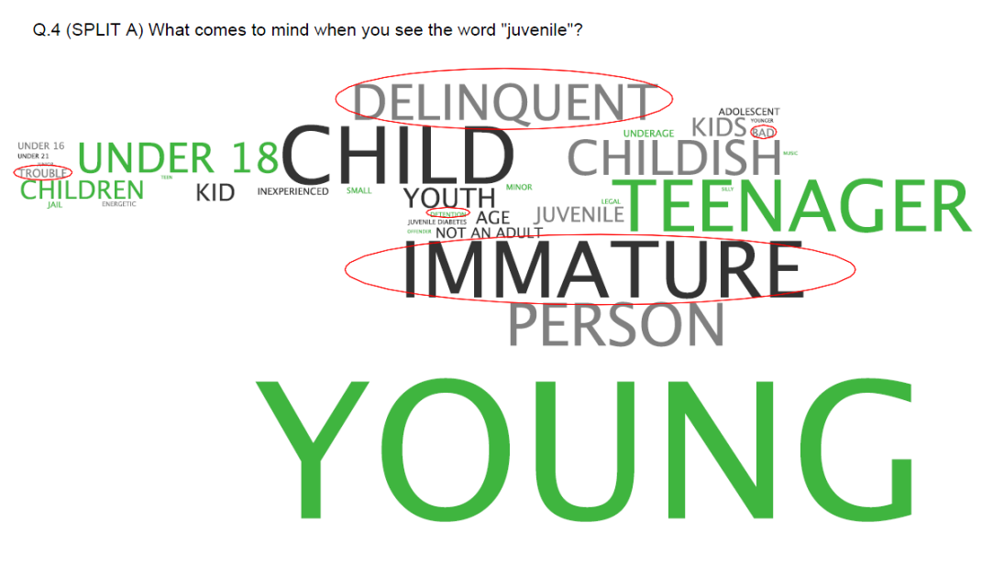
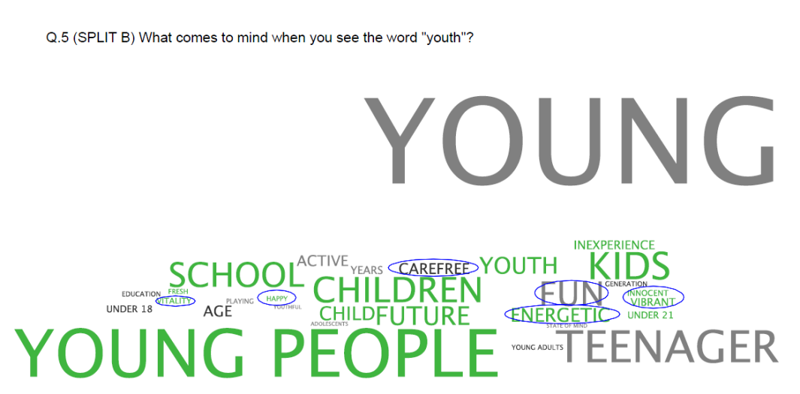
“Juvenile” Elicits Negative Reactions; “Youth” Much More Positive
Juvenile
Youth
Q4. (SPLIT A) What comes to mind when you see the word “juvenile”?
Q4. (SPLIT B) What comes to mind when you see the word “youth”?

Slide 9
Strategic Recommendations

Slide 10
Recommendation #1
Embrace the concept of accountability or responsibility.

Slide 11
Recommendation #2
Recognize that the ultimate goal is reducing crime and rigorous rehabilitation is the best path to this outcome.

Slide 12
Recommendation #3 – Language Tips
Youth, not juvenile
Use terms like rigorous and required to make rehabilitation feel tough

Slide 13
Message Triangle
RIGOROUS REHABILITATION TO REDUCE REPEAT OFFENSES
ACCOUNTABILITY
SAFETY
COMMON SENSE
Figure 12

